Slide 1

Why learn
1
Open source
2
Large community
3
Contains all you may needed
4
Used on every field
5
Free
6
Gateway to a well paid job

Slide 2
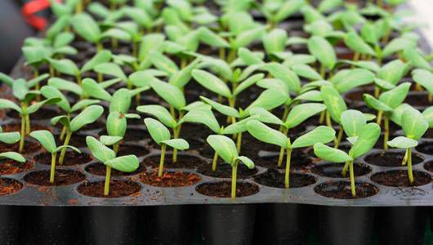
Expensive
High mortality

Slide 3






The Individual
The Sample
The Population

Slide 5


Replicates
0mg
10mg
20mg
Control
Treatments
Independent variable

Slide 6
0mg
10mg
20mg

Slide 7
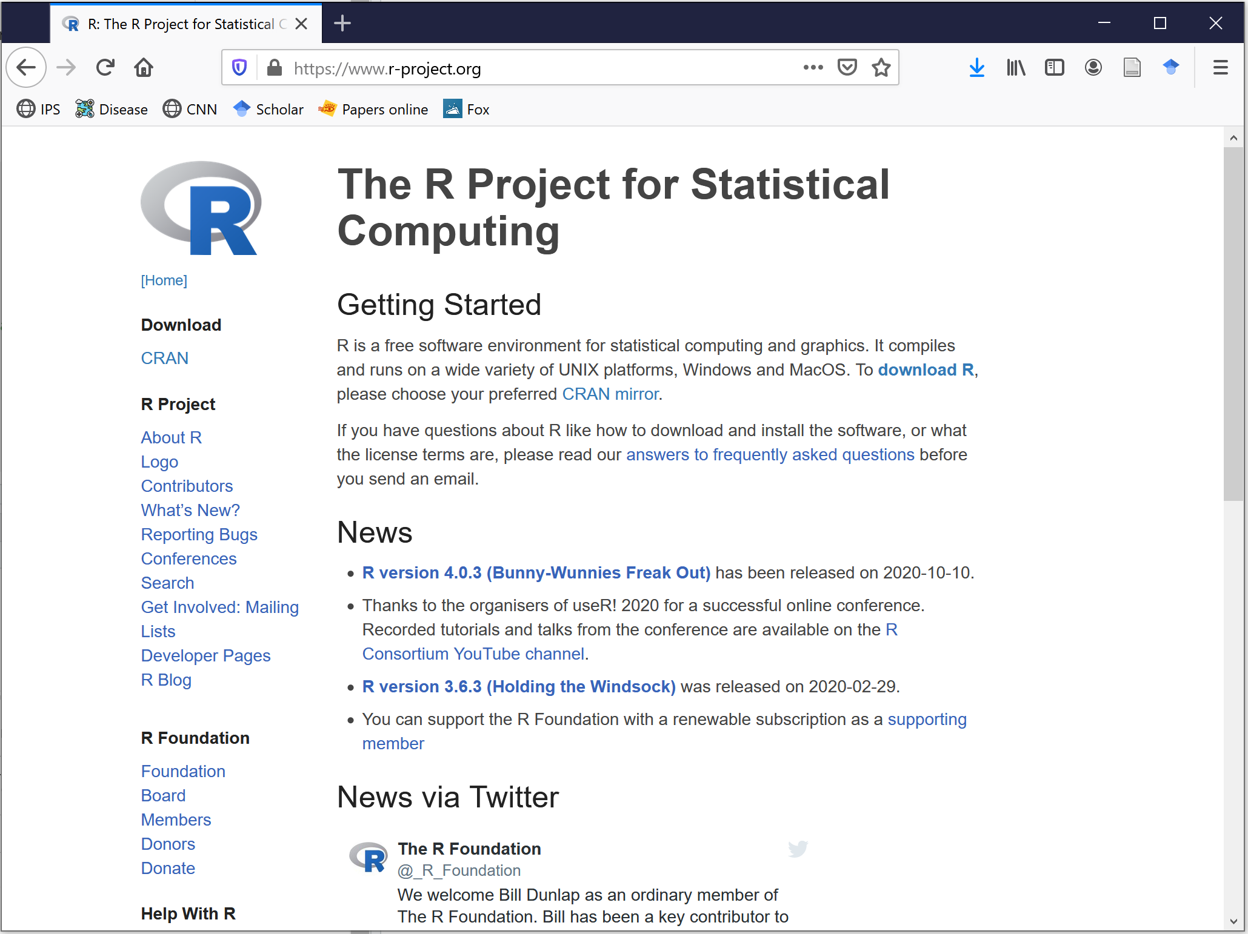

Slide 8
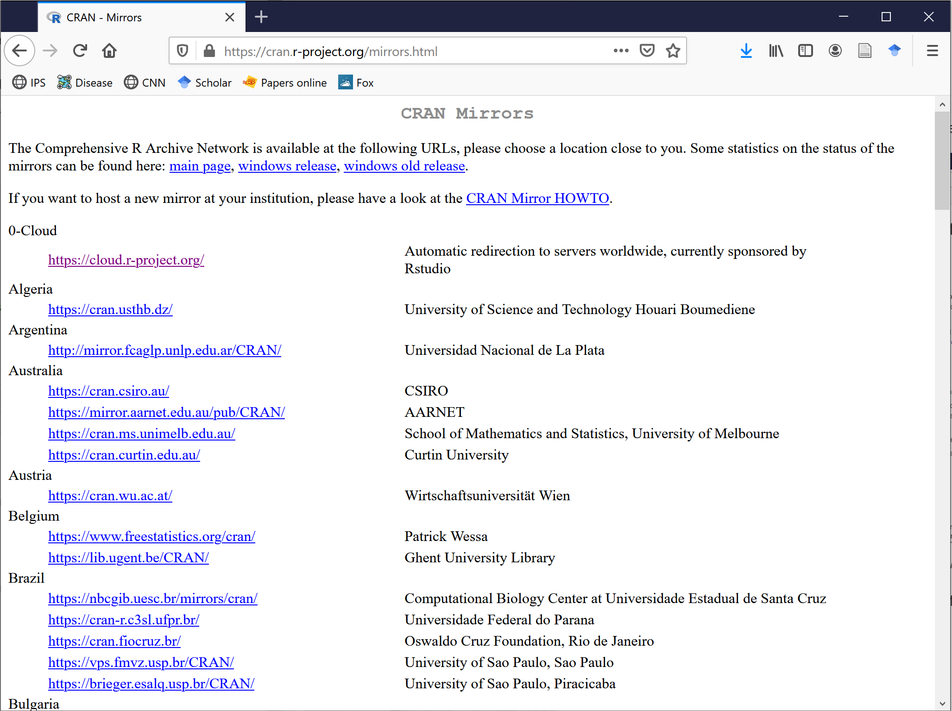

Slide 9
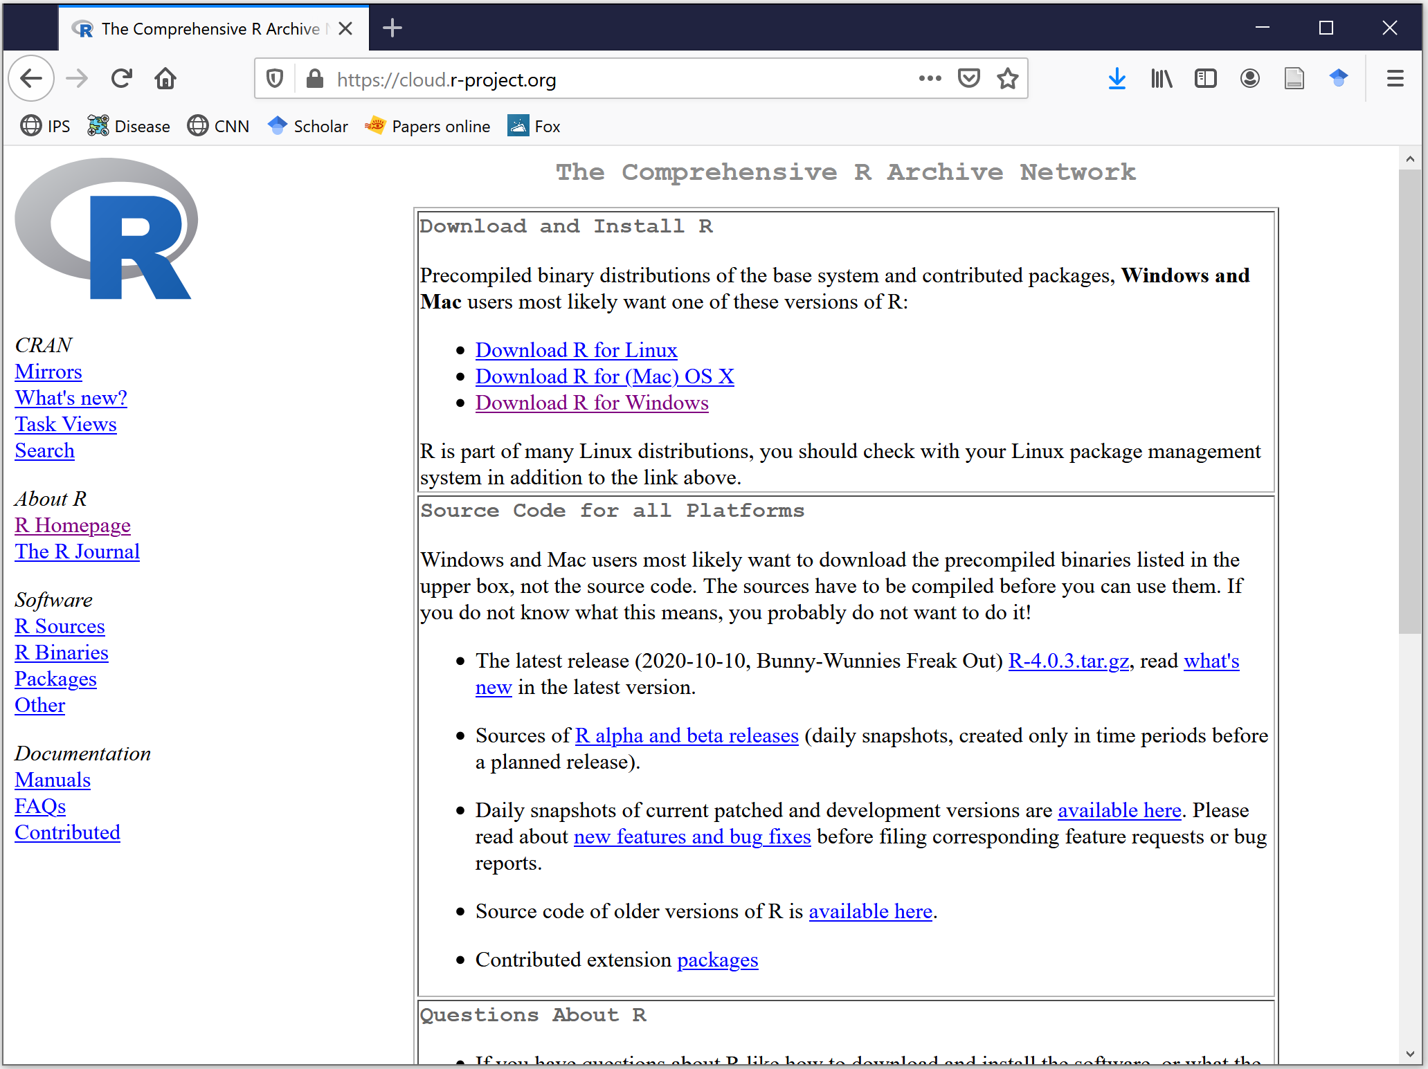

Slide 10
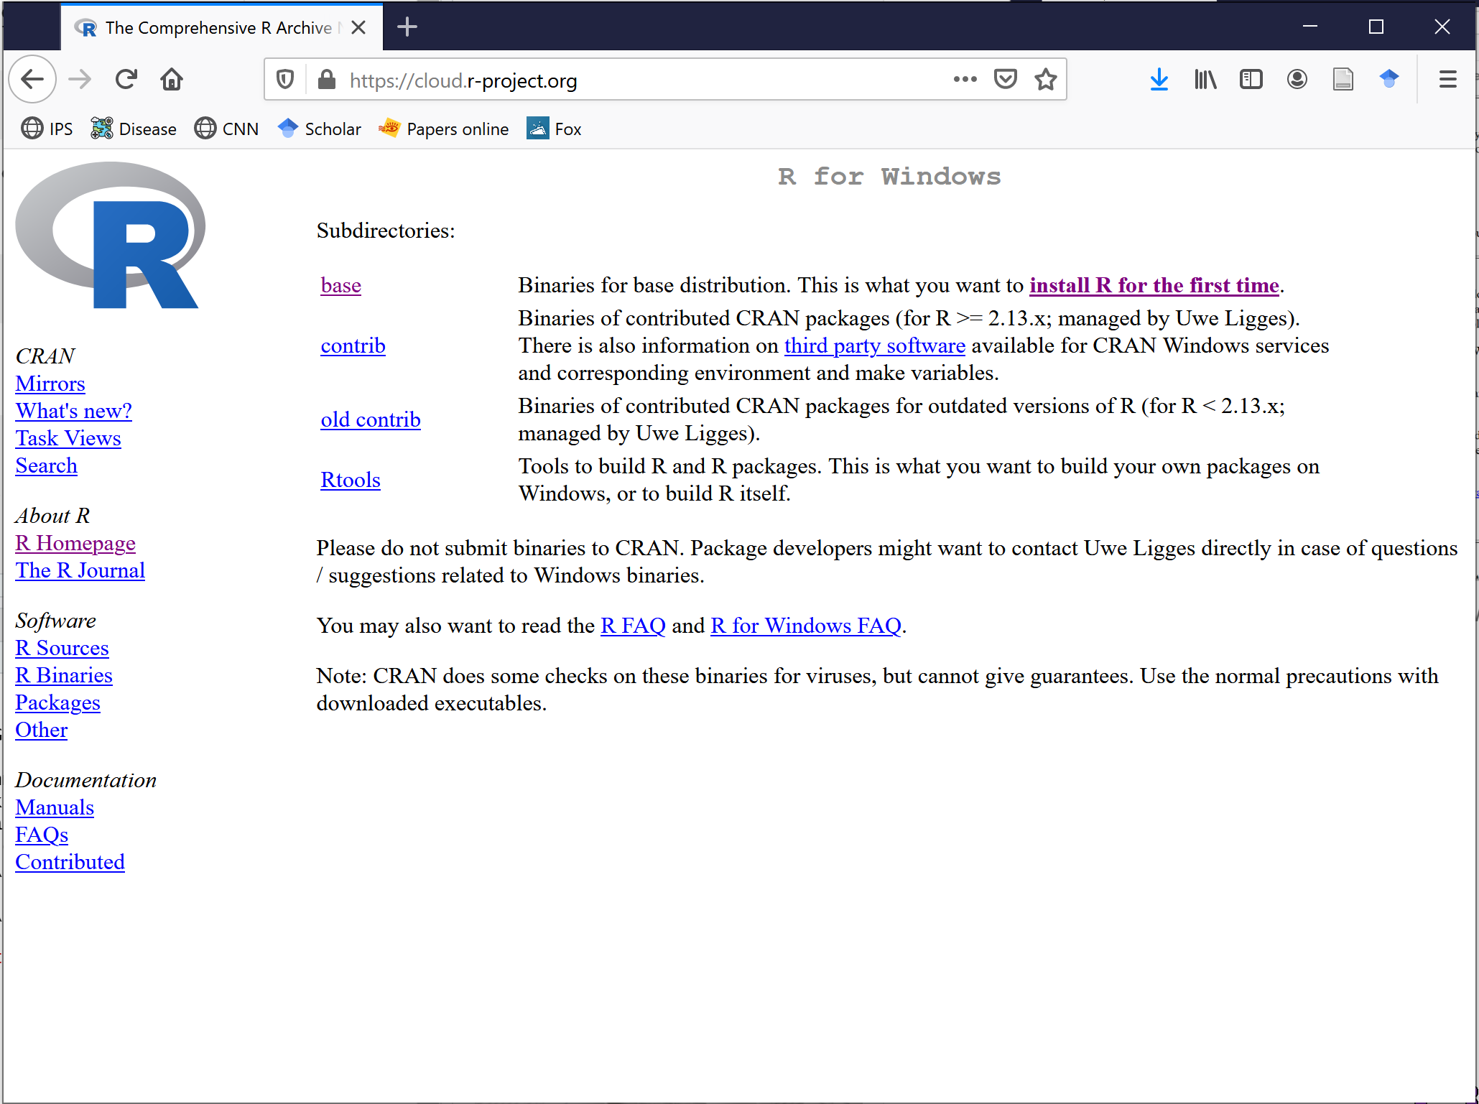

Slide 11
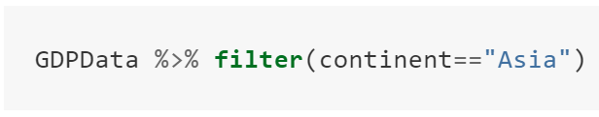
Dataframe
Function
Pipe
Condition

Slide 12
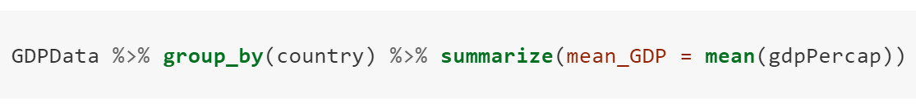
Dataframe
Operation #1
Operation #2
Function to apply
Pipe #1
Pipe #2
Variable name of result
Data to apply function to

Slide 13
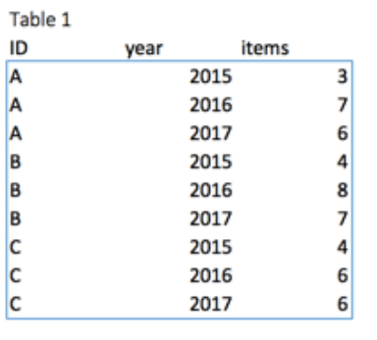
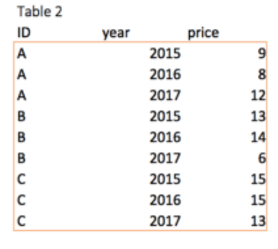
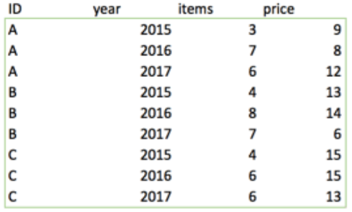
+

Slide 14
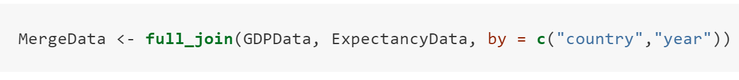
Name for results
Common columns to merge by
Function
Database 1
Database 2
Merge by

Slide 15
Measures of central tendency
Median
Mean
Mode
Trimmed mean
Geometric mean
Harmonic mean
Weighted mean

Slide 16











10% 20% 30% 40% 50% 60% 70% 80% 90 %
45cm
10% 20% 30% 40% 50% 60% 70% 80% 90 %

Slide 17
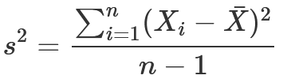
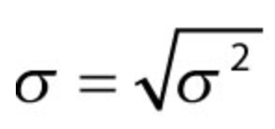
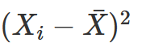
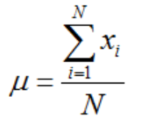
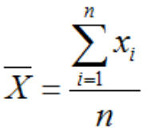
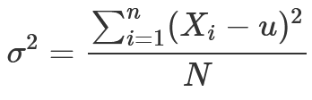
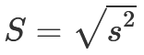


Slide 18
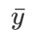

Y
Y
High y
Low x
Y
High y
High y
High y
*
Low x
High x
*
High x
*
*
*
*
*
*
*
*
*
*
*
*
*
*
*
*
*
*
*
*
*
*
*
*
*
*
Low y
*
*
*
*
Low y
Low x
*
High x
Low y
Low y
X
X
Low x
High x
X
Low y
Low x

Slide 19
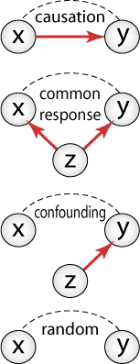

Slide 20

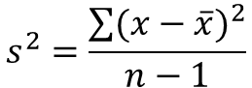
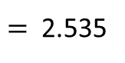
The Variance
The variance measures how far a set of numbers is spread out from their average value
$$s^{2}=\frac{\sum{{(x−\overline{x})}^{2}}}{n−1}$$
$$= \frac{{(−2.1)}^{2}+{(−0.8)}^{2}+{(−0.2)}^{2}+{(1.2)}^{2}+{(1.9)}^{2}}{5−1}$$
$=$ 2.535
ss
1.9
Hours a week of study
Peter
Laura
John
Chip
Tom
1.2
0.5
1.8
2.4
3.8
4.5
-0.8
-0.2
‾x=2.6
-2.1
Peter
Laura
John
Chip
Tom
Hours a week of study
0 1 2 3 4 5

Slide 21



The CoVariance
The covariance is a “precursor” to calculate the strength of the relationship between two variables
The CoVariance
The Variance
$$s^{2}=\frac{\sum{(\text{x}\text{−}\overline{x})∗(y−\overline{y}) }}{n−1}$$
$$=\frac{\left(−2.1\right)\left(−19.2\right)+\left(−0.8\right)\left(−10.2\right)+\left(−0.2\right)\left(0.8\right)+\left(1.2\right)\left(7.8\right)+(1.9)(20.8)}{5−1}$$
$$s^{2}=\frac{\sum{{(x−\overline{x})}^{2}}}{n−1}$$
Test
Score
(%)
100
+1.9
Tom
Name | Hours a week of study | Final score
Peter | 0.5 | 55
Laura | 1.8 | 64
John | 2.4 | 75
Chip | 3.8 | 82
Tom | 4.5 | 95
+20.8
90
Chip
-0.2
↓
80
+1.2
+0.8→
+7.8
John
‾y=74.2
70
-10.2
Laura
-0.8
60
-19.2
Peter
-2.1
50
1 2 3 4 5
Peter
Laura
John
Chip
Tom
‾x=2.6
Hours a week of study

Slide 22
…Let’s understand what the COVARIANCE is doing?…
100
‾x=2.6
+
Tom
90
Chip
Test
Score
(%)
80
John
‾y=74.2
70
+
Laura
60
Peter
50
Peter Laura John Chip Tom
1 2 3 4 5
Hours a week of study

Slide 23
…Let’s understand what the COVARIANCE is doing?…
100
-
-
+
90
Test
Score
(%)
80
70
-
60
-
+
50
1 2 3 4 5
Hours a week in Facebook

Slide 24
…the idea with COVARIANCE is that is can allow to classify relationships that are…
100
100
100
Negative
Positive
No relationship
90
90
90
80
80
80
70
70
70
60
60
60
50
1 2 3 4 5
50
1 2 3 4 5
50
1 2 3 4 5

Slide 26
100
Tom
90
Chip
Test
Score
(%)
80
John
…students that studied long scored high in their tests…
70
…the relationship between time studying and the test scores can be summarized with this line…
Laura
60
…students that studied briefly scored low in their tests…
Peter
50
Peter Laura John Chip Tom
1 2 3 4 5
Hours a week of study

Slide 27
100
Tom
90
…this relationship has a positive slope…
…basically, when you study long….
Chip
…you score high in the test….
Test
Score
(%)
80
…AND….
John
…when you study briefly….
…you score low….
70
Laura
60
Peter
50
Peter Laura John Chip Tom
1 2 3 4 5
Hours a week of study

Slide 28
100
90
…this relationship has a negative slope…
…basically, when you spend a lot of time in Facebook….
…you score low in the test….
Test
Score
(%)
80
…AND….
…when you use Facebook briefly….
…you score high….
70
60
50
1 2 3 4 5
Hours a week in Facebook

Slide 29
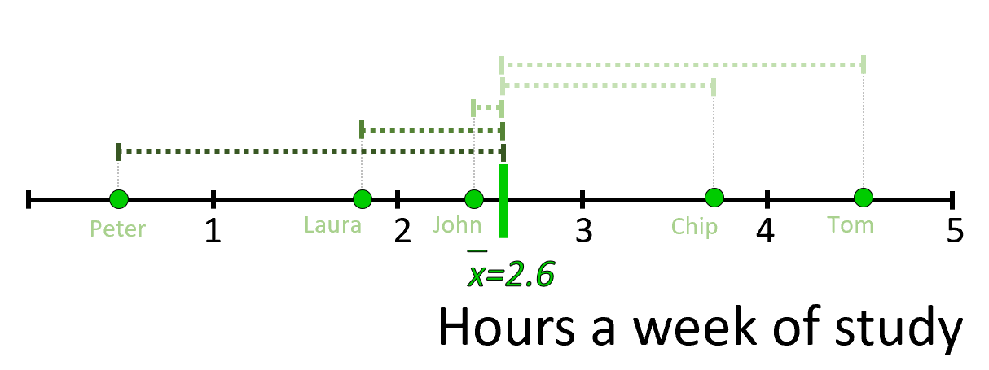
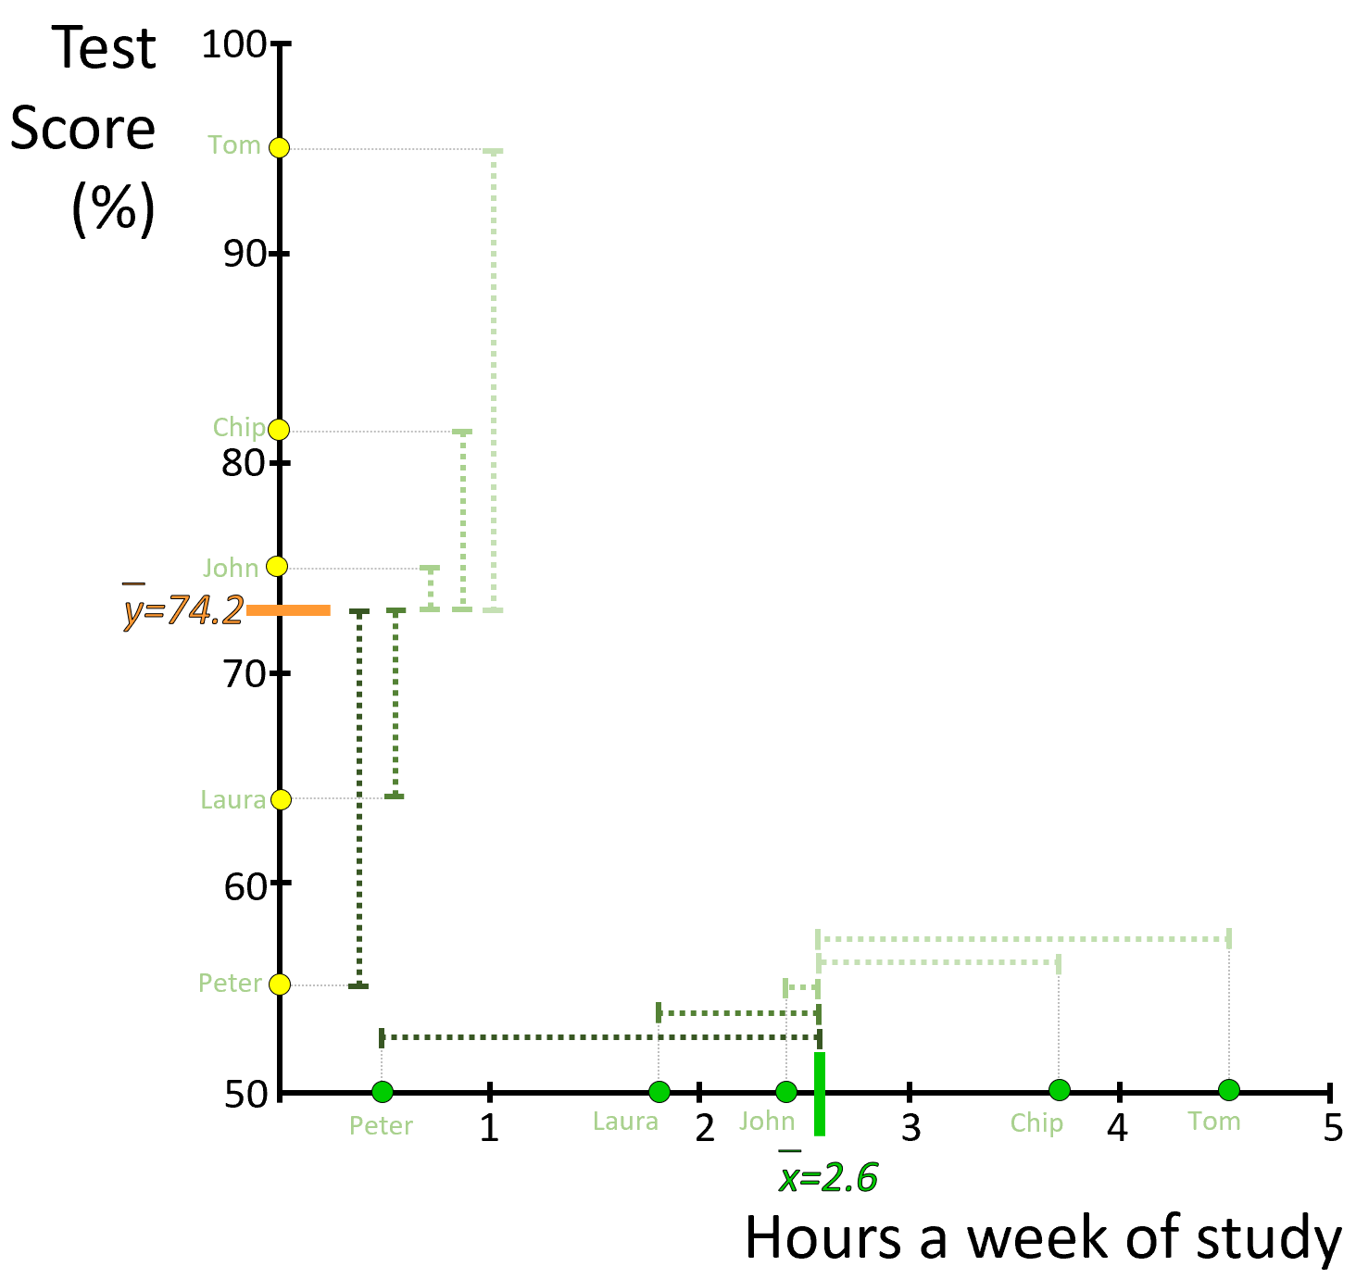
1.2
1.9
-0.8
-0.2
-2.1
20.8
7.8
0.8
-10.2
-19.2
1.2
1.9
-2.1
-0.8
-0.2

Slide 30
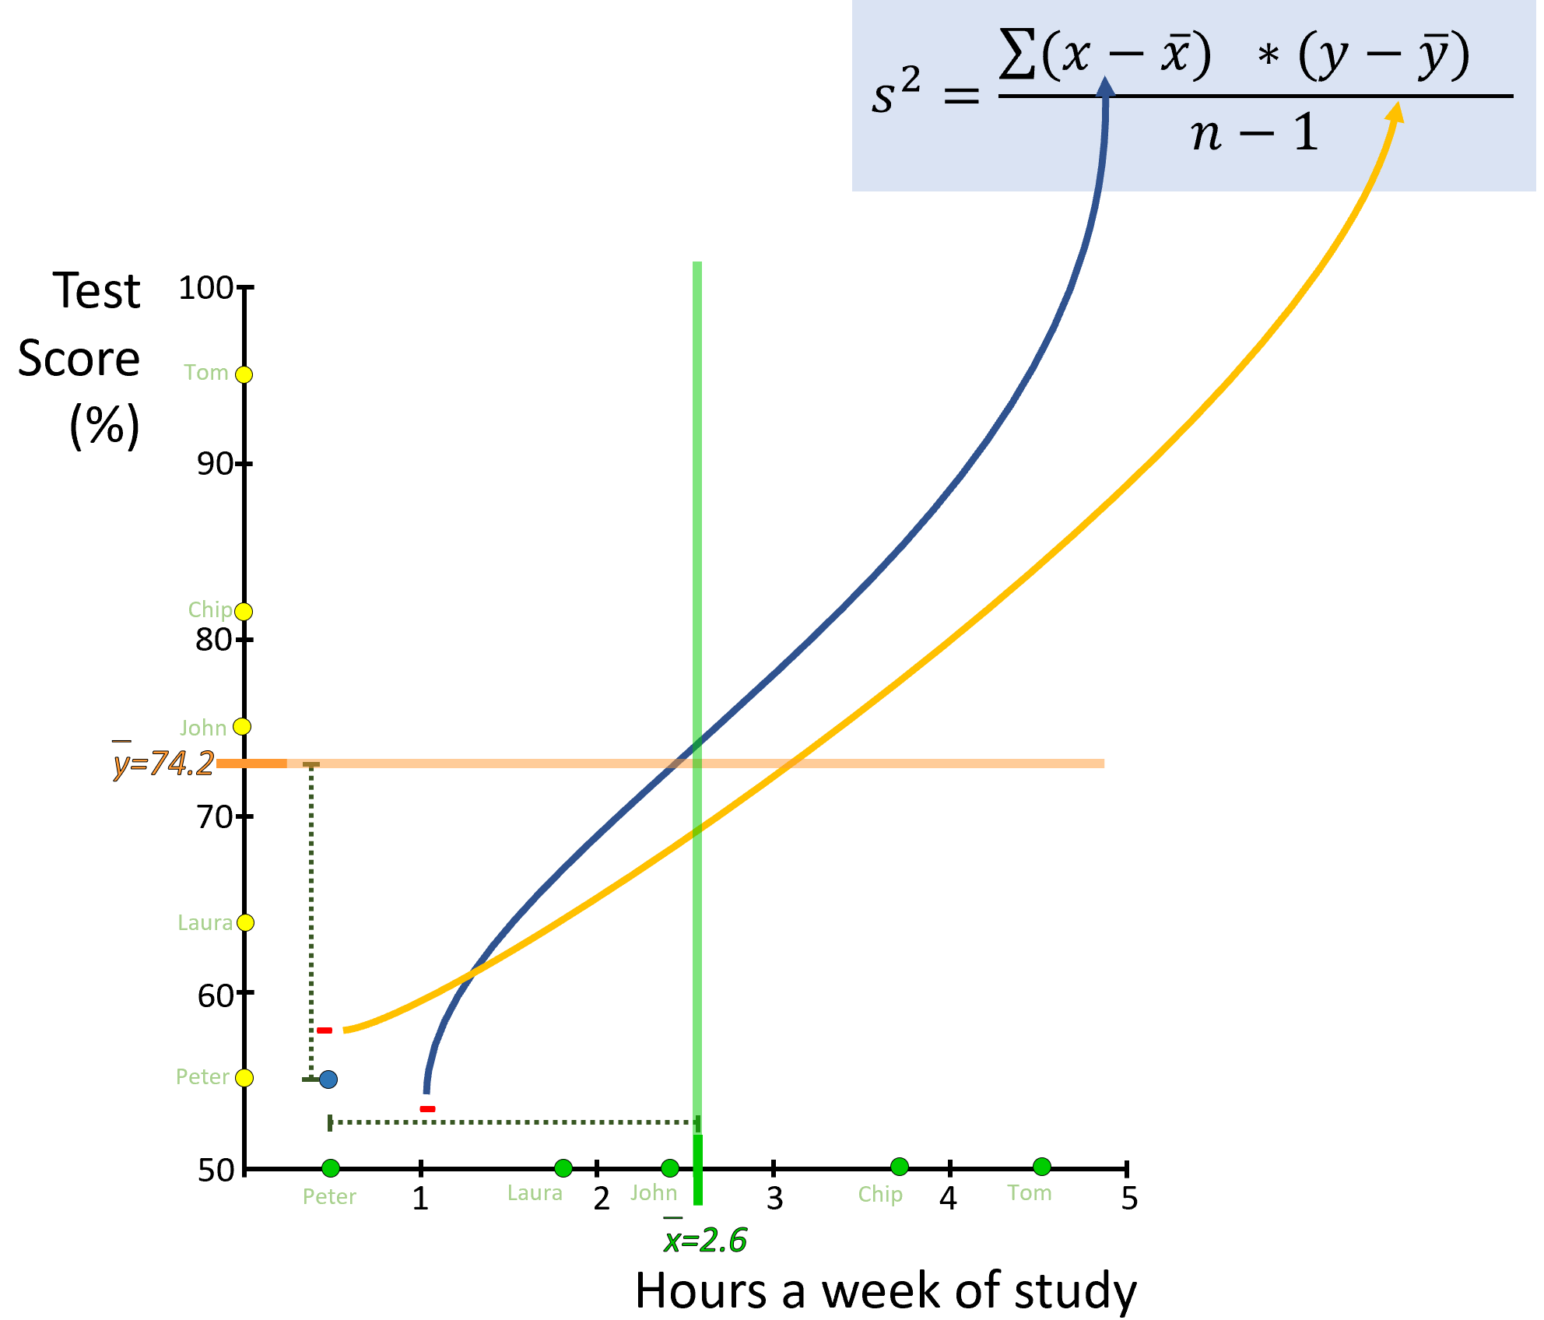
-19.2
-2.1

Slide 31
100
100
100
90
90
90
80
80
80
70
70
70
60
60
60
50
1 2 3 4 5
50
1 2 3 4 5
50
1 2 3 4 5

Slide 32
100
100
90
90
80
80
70
70
60
60
50
50
1 2 3 4 5
1 2 3 4 5

Slide 33
100
100
90
90
80
80
70
70
60
60
50
1 2 3 4 5
50
1 2 3 4 5

Slide 34
Test
Score
(%)
100
?
?
Tom
90
Chip
80
John
70
?
?
Laura
60
Peter
50
Peter Laura John Chip Tom
1 2 3 4 5
Hours a week of study

Slide 35
Y
100
90
80
←The Slope→
70
*
←
60
The intercept
50
1 2 3 4 5
X

Slide 36
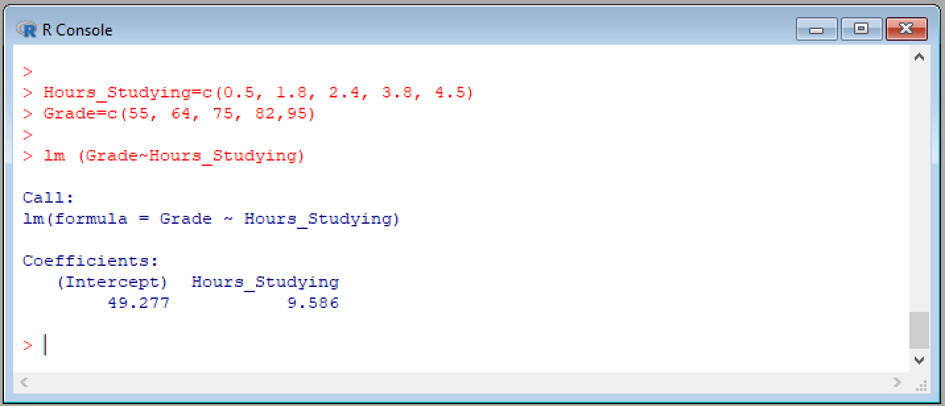
The model
Intercept
Slope

Slide 37
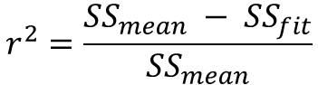
The coefficient of determination, r²
Test
Score
(%)
Test
Score
(%)
100
100
Sum of Squares around the Fit, SS_{fit}
Tom
Tom
90
90
Chip
Residuals
Chip
$$r^{2}=\frac{{SS}_{mean} − {SS}_{fit}}{{SS}_{mean}}$$
80
80
John
John
‾y=74.2
70
70
Laura
Laura
Sum of Squares around the Mean, SS_{mean}
60
60
Peter
Peter
50
50
1 2 3 4 5
Peter
Laura
John
Chip
Tom
Hours a week of study

Slide 38
100
90
80
70
60
50
1 2 3 4 5

Slide 39
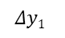
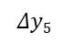

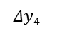
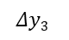
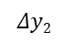
Test
Score
(%)
Sum of Squares around the Mean
SS_{mean}
100
Tom
90
$$Δy5$$
Chip
80
$$Δy4$$
John
$$Δy3$$
‾y=74.2
70
$$Δy2$$
Laura
60
$$Δy1$$
Peter
50
${{SS}_{mean}=(Δy1)}^{2}$+${(Δy2)}^{2}$ + ${(Δy3)}^{2}$ + ${(Δy4)}^{2}$ + ${(Δy5)}^{2}$

Slide 40
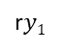
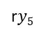

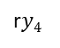

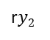
Test
Score
(%)
Sum of Squares around the Fit
SS_{fit}
100
Tom
r$y5$
90
Chip
r$y4$
80
John
$$ry3$$
70
r$y2$
Residuals
Laura
60
Peter
r$y1$
${{SS}_{fit}=(ry1)}^{2}$+${(ry2)}^{2}$ + ${(ry3)}^{2}$ + ${(ry4)}^{2}$ + ${(ry5)}^{2}$
50
1 2 3 4 5
Peter
Laura
John
Chip
Tom
Hours a week of study

Slide 41
Extrapolation
Interpolation
Extrapolation
100
90
Test
Score
(%)
80
70
60
50
1 2 3 4 5
Hours a week of study

Slide 42
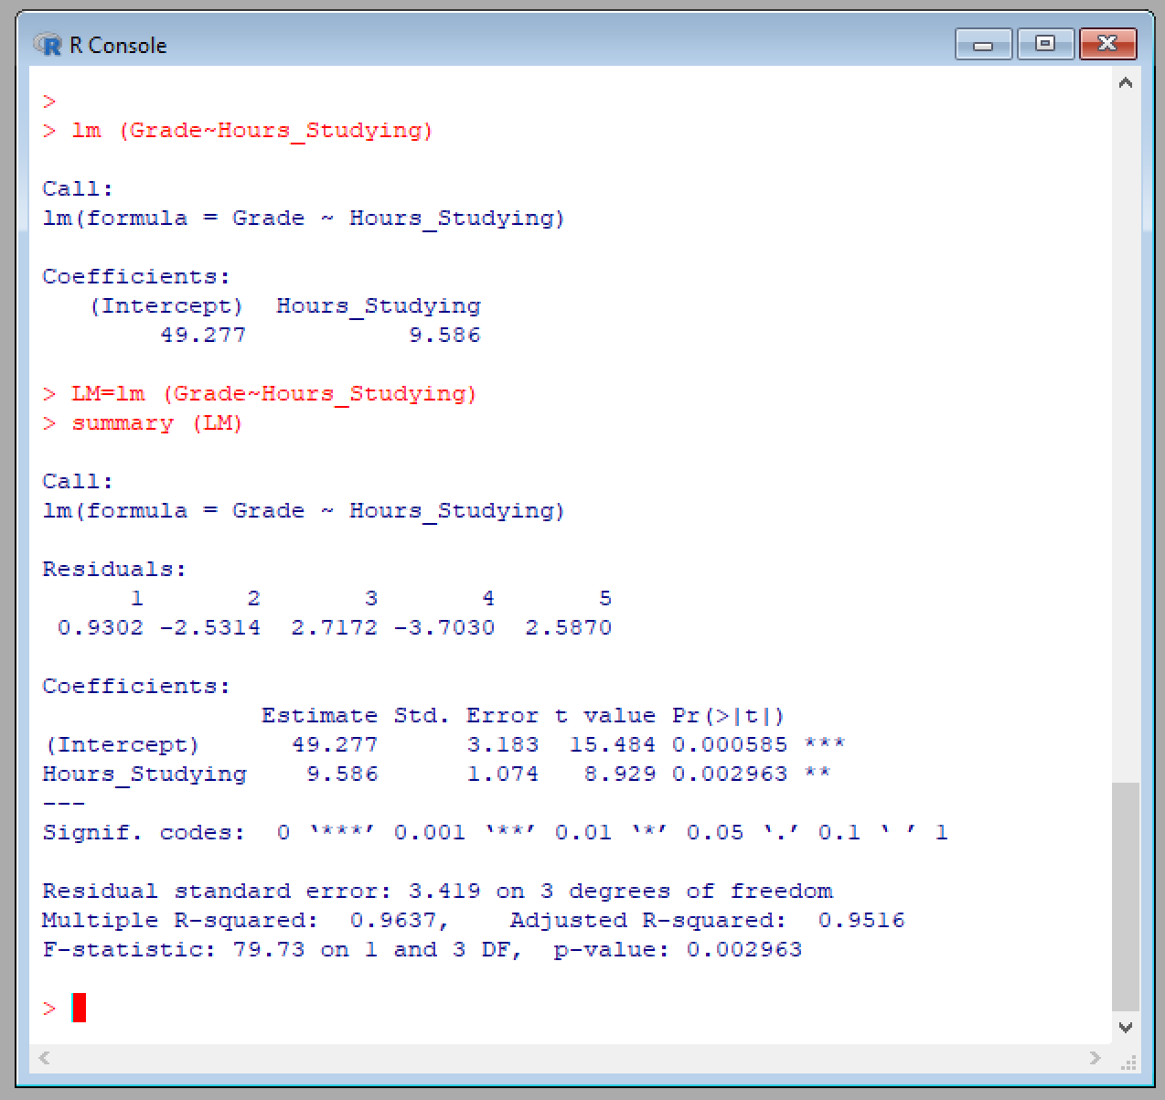
F-value
P-value

Slide 43
The model
Intercept
Slope
F-value
r²
P-value

Slide 46
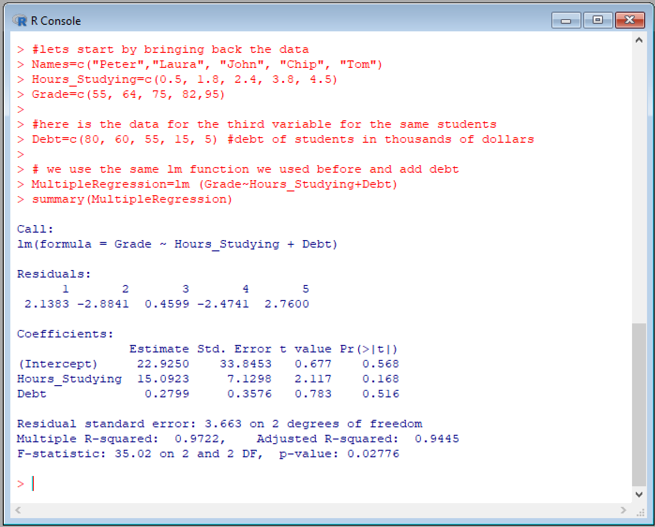
Multiple regression
Intercept
Slopes
P-values for Individual variables
P-values for full model

Slide 47












?
6.8
8.8
Size
1
1.5
3.5
3.6
4
4.5
5.1
5.6
6.1
7

Slide 48


Bad←→Good
Type II error
(so-call false negative)
I accept the null hypothesis when it is, in fact, false.
I did not do things thinking they were bad but ended up being good. I lost in life.
No error here
I did all things I know were good
I ended up in heaven doing everything right
Heaven
↑
↓
Hell
←God’s divine judgement
Type I error
(so-call false positive)
I reject the null hypothesis when it is, in fact, true.
I did things thinking there were good but were actually bad.
I cost me dearly; this error could send me to hell.
No error here
I did all things I know were bad
I ended up in hell but I was confident of it
↑
Human judgement (α)

Slide 49
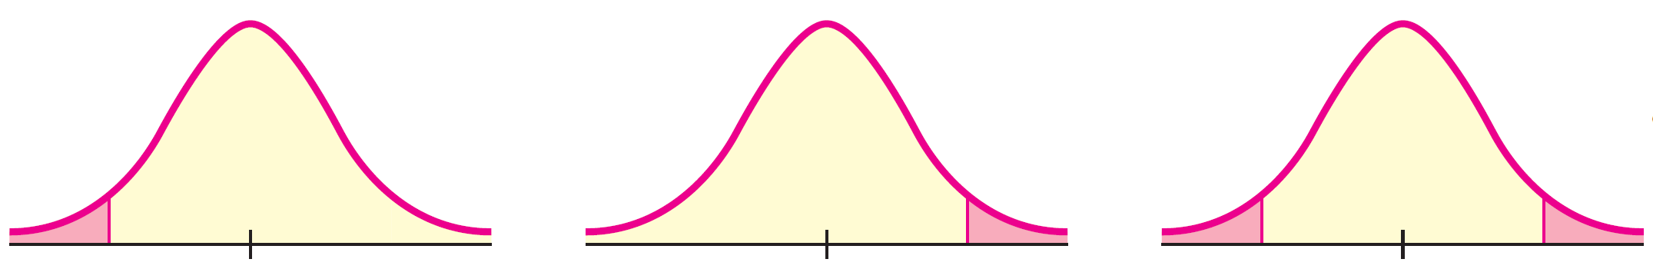
H_{o}: u >= k
H₁: u < k
Left-sided test
H_{o}: u <= k
H₁: u > k
Right-sided test
H_{o}: u = k
H₁: u ≠ k
Two-tail test
Reject
Reject
Reject
Reject
α
α
α/2
α/2

Slide 50
Goal: test for significant differences
One sample
Two-samples
More than two samples
Population standard deviation known?
Yes No
Population standard deviation known?
Yes No
Sample size above 30?
Yes No
Sample size above 30?
Yes No
Z-test
T-test
ANOVA

Slide 51
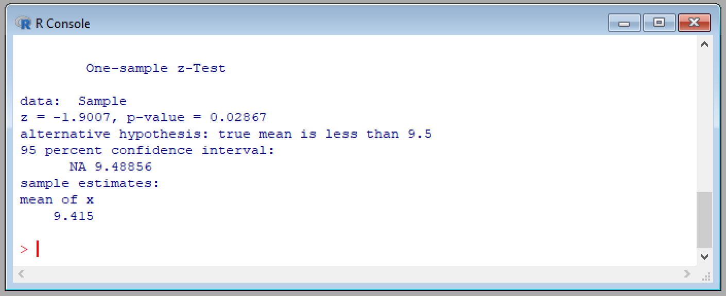
Z-value
P-value

Slide 52
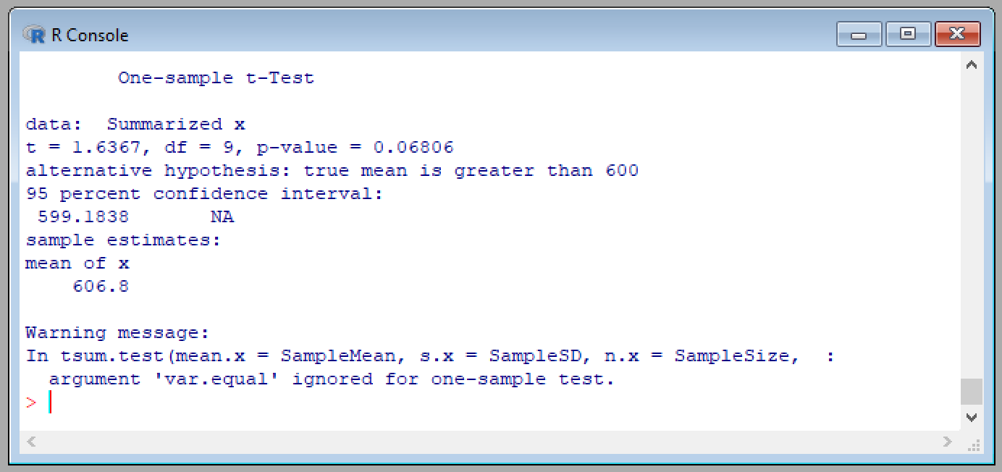
Calculated T-value
P-value

Slide 53
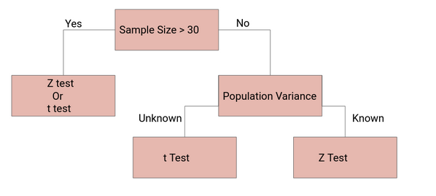
Population standard deviation known?
Yes No
Sample size above 30?
Yes No
Z-test
T-test

Slide 54
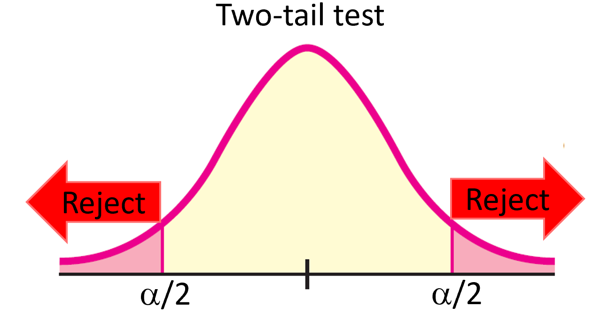
Stating a hypothesis
Problem: a gas station owner is concerned about his gas pumps not dispensing the legal volume of one gallon for each gallon registered at the pump.
Status quo
How things normally are
True parameter
Null hypothesis or HO or H0:
Gas volume = 1 gallon
Question of interest
Alternative hypothesis or HA or H1:
Gas volume ≠ 1 gallon

Slide 55
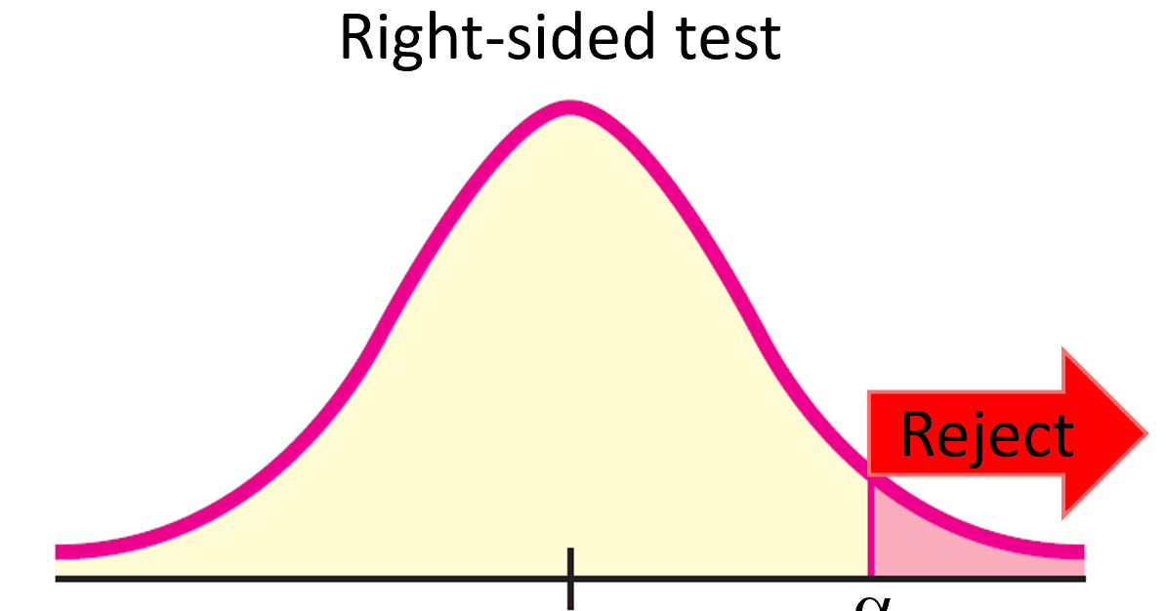
Stating a hypothesis
Problem: The average yearly temperature in Hawaii is 25.5ºC and a scientist is concerned that recent temperatures are becoming hotter.
<
H0: Hawaii temperature = 25.5ºC
HA: Hawaii temperature > 25.5ºC
Greater than

Slide 56
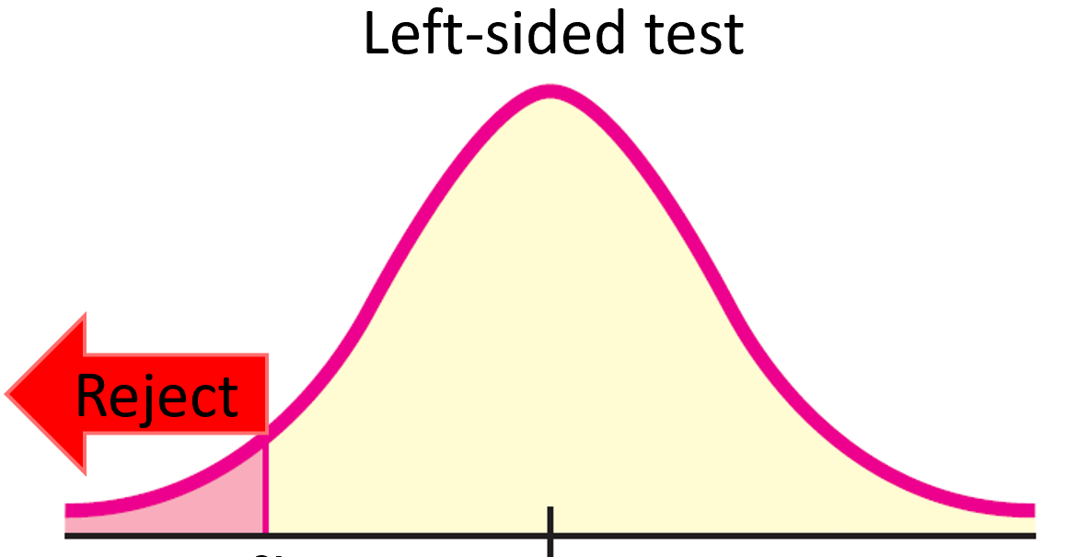
Stating a hypothesis
Problem: A company has advertised that their light bulbs last 8,000hours, but has received numerous customer complains that the bulbs last much less.
>
H0: Bulb lifespan = 8,000 hours
HA: Bulb lifespan < 8,000 hours
Less than

Slide 57
HA: Given parameter is less than

Slide 58
HA: Given parameter is greater than

Slide 59
HA: Given parameter is different

Slide 60
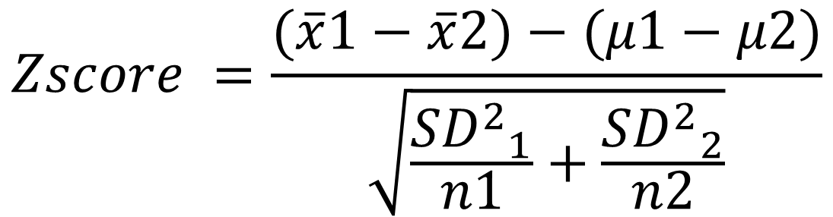
Sample means
Population means
$$Zscore =\frac{(\overline{x}1−\overline{x}2)−(μ1−μ2)}{\sqrt{\frac{{{SD}^{2}}_{1}}{n1}+\frac{{{SD}^{2}}_{2}}{n2}}}$$
Population standard deviations

Slide 61

Sample means
Population means
T$score =\frac{(\overline{x}1−\overline{x}2)−(μ1−μ2)}{\sqrt{\frac{{{SD}^{2}}_{1}}{n1}+\frac{{{SD}^{2}}_{2}}{n2}}}$
Sample standard deviations

Slide 62

Sample mean
Population mean
Z$score =\frac{(\overline{x}−μ)}{\frac{SD}{\sqrt{n}}}$
Sample size
Population standard deviation

Slide 63

Sample mean
Population mean
T$score =\frac{(\overline{x}−μ)}{\frac{SD}{\sqrt{n}}}$
Sample size
Sample standard deviation

Slide 64

Calculated Z-value
P-value

Slide 65

Calculated T-value
P-value

Slide 66



One-Way ANOVA
?
?
=
=

Slide 67


Two-Way ANOVA
?
?
=
=
?
?
?
=
=
=

Slide 68



Total Variance
$${SS}_{t}=\sum{{(x−\overline{X})}^{2}}$$
$${DF}_{t}=n−1$$
Grand mean, $\overline{X}$

Slide 69



Between group variance
$${SS}_{b}=\sum{{n_{i}(x_{i}−\overline{X})}^{2}}$$
$${DF}_{b}=k−1$$
Grand mean, $\overline{X}$
‾x₃
‾x₂
‾x₁

Slide 70


Within group variance
$${SS}_{w}=\sum{{(x−{\overline{x}}_{i})}^{2}}$$
$${DF}_{w}=n−k$$
‾x₃
‾x₂
‾x₁

Slide 71



Total Variance
${SS}_{t}=\sum{{(x−\overline{X})}^{2}}$= ${(1−4)}^{2}+{(2−4)}^{2}+{(3−4)}^{2}+{(3−4)}^{2}+{(4−4)}^{2}+{(5−4)}^{2}+{(5−4)}^{2}+{(6−4)}^{2}+{(7−4)}^{2}$ = 30
$${DF}_{t}=n−1=8$$
Grand mean, $\overline{X}$, =4
1 2 3 4 5 6 7
Tomatoes produced

Slide 72



Between group variance
${SS}_{b}=\sum{{n_{i}(x_{i}−\overline{X})}^{2}}$= ${3(2−4)}^{2}+{3(4−4)}^{2}+{3(6−4)}^{2}$= 24
$${DF}_{b}=k−1=2$$
Grand mean, $\overline{X}$, =4
‾x₃=6
‾x₂=4
‾x₁=2
1 2 3 4 5 6 7
Tomatoes produced

Slide 73


Within group variance
${SS}_{w}=\sum{{(x−{\overline{x}}_{i})}^{2}}$= ${(1−2)}^{2}+{(2−2)}^{2}+{(3−2)}^{2}+{(3−4)}^{2}+{(4−4)}^{2}+{(5−4)}^{2}+{(5−6)}^{2}+{(6−6)}^{2}+{(7−6)}^{2}$ = 6
${DF}_{w}=n−k=9 −3$ = 6
‾x₃=6
‾x₂=4
‾x₁=2
1 2 3 4 5 6 7
Tomatoes produced

Slide 74


$F_{statistic}=\frac{Variance between groups}{Variance within groups}= \frac{\frac{{SS}_{b}}{{DF}_{b}}}{\frac{{SS}_{w}}{{DF}_{w}}}$
$F_{statistic}=\frac{Variance between groups}{Variance within groups} = \frac{\frac{{SS}_{b}}{{DF}_{b}}}{\frac{{SS}_{w}}{{DF}_{w}}}$ = $\frac{\frac{24}{2}}{\frac{6}{6}}$ = 12
 | Sum of Squares, SS | Degrees of Freedom, DF
Within groups | 6 | 6
Between groups | 24 | 2
Total | 30 | 8

Slide 75

DFb→
DFw↓

Slide 76


Calculated F-statistic
Alpha,α
P-value
Calculated F-statistic
P-value

